Slide 1
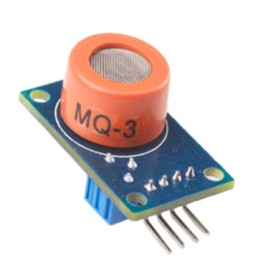

SRI BALAJI CHOCKALINGAM ENGINEERING COLLEGE - ARNI
DEPARTMENT OF ELECTRONICS AND COMMUNICATION ENGINEERING
PROJECT
PANDEMIC-PREVENTING SYSTEM BASED ON
MQ-3 SENSOR
GUIDED BY,
PRABAGARAN D, M.E
PROJECT BY,
HARIKARAN P
VIJAY M , DECE
SRIDHAR M
KIRUBHANITHI A , DECE

Slide 2
CONTENT
Recap of zeroth review.
What is Servo Motor.
How we use Servo?
Demo video.
Conclusion.

Slide 3
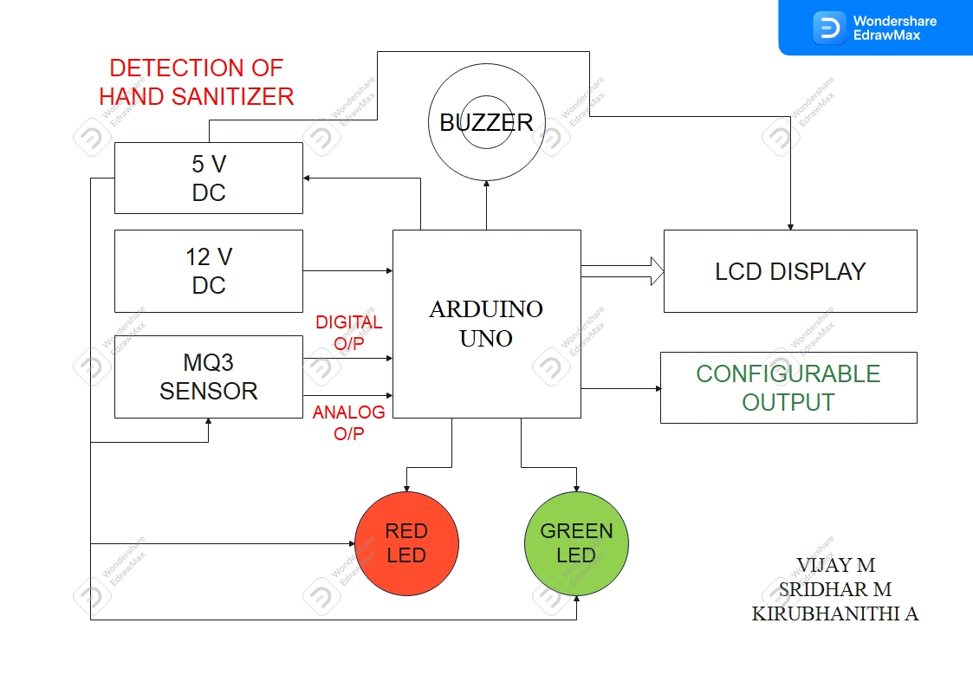
RECAP OF ZEROTH REVIEW

Slide 4

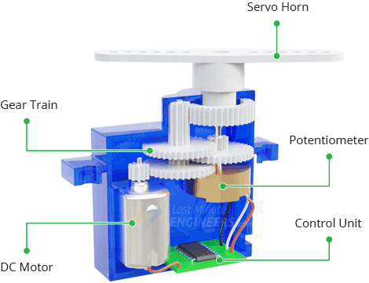
WHAT IS SERVO MOTOR?
Servos are motors that allow you to precisely control physical movement because they generally move to a position rather than continuously rotating.
The potentiometer provides position feedback to the error amplifier in the control unit, which compares the current position of the motor to the target position.

Slide 5
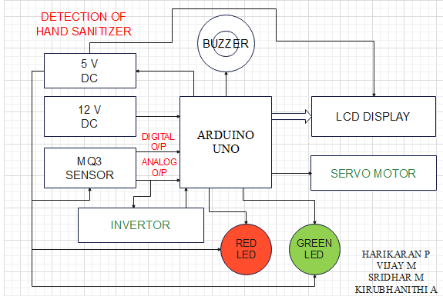
HOW WE USE SERVO?

Slide 6

DEMO VIDEO

Slide 7
CONCLUSION
This device can allow the person to get into shops , Malls and companies, when they sanitize hands.
The MQ3 sensor and servo motor are very low cost electronic product , So the small shops also can afford this product easily.
Definitely, this product can contribute to reducing the transmission of viruses in pandemic situations.

Slide 8



THANK YOU!

